Slide 1
Using JS In Python
Abhiram R (@abhicantdraw)

Slide 2
I’M Abhiram
Senior ML Engineer, O9 Solutions
Write code and short stories
Co-organize Python meetups at Bangpypers (@__bangpypers__
Run a bookclub in Bangalore (Broke Bibliophiles Bangalore @bibliophilesblr)

Slide 3
What am I Doing in a JS conference?
Cons
One more thing to learn
Too many frameworks (Bane of choice)
Pros
Not a need, but improves the overall experience considerably
Helps in separation of concerns (UI – Business logic)
Allows for a broader usage of UI and UX capabilities

Slide 4
Where can we use JS in Python?
Webapps
Django
Flask
Streamlit
Jupyter Notebooks

Slide 5
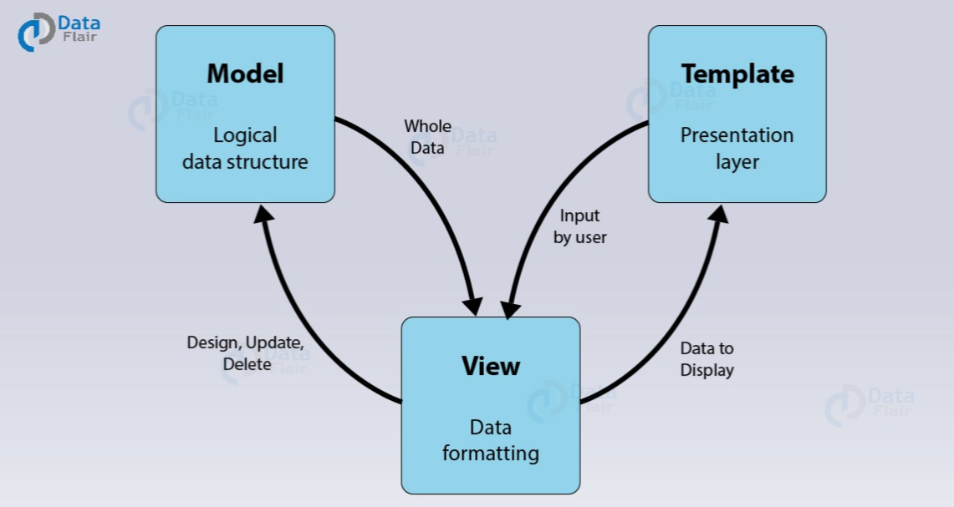
Typical Django App

Slide 6
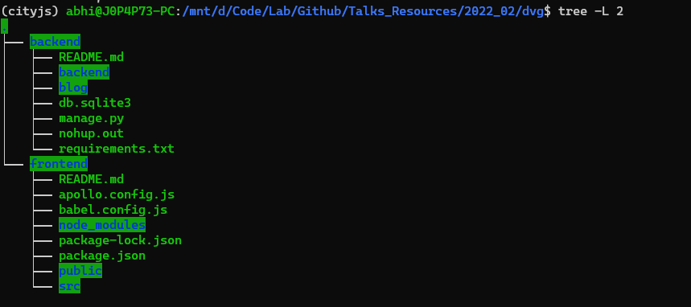
JS-ified Django App

Slide 7
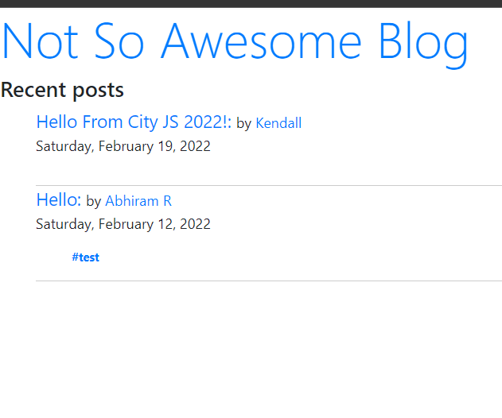
Django App Demo

Slide 8
What have we achieved here?
Separated views and logic
Made it easier to interface with GraphQL
Adding new views and templating is very easy and more flexible than Jinja templating.

Slide 9
Streamlit Demo 1
2 React Hooks – Use Effect, Use State
UseEffect : Lets you perform side effects in function components
UseState : A way to “preserve” some values between the function calls

Slide 10
Streamlit Demo 2
Displaying a discrete slider instead of a continuous one.
Similar Elements. Different structural options for streamlit coding.

Slide 11
In Jupyterhub Notebooks
For creating new extensions.

Slide 12
References
https://realpython.com/python-django-blog
https://vuejs.org/ (Official documentation)
https://discuss.streamlit.io/categories
https://share.streamlit.io
https://github.com/abhiramr/Talks_Resources/tree/master/2022_02

Slide 13
Thank you! ☺
abhicantdraw on Twitter
abhicantdraw@gmail.com
Engineering guidance/project architecture tips (CS)/If you want to know about a career in Data Science and ML Engineering (mail/DM on Twitter)

